Slide 1
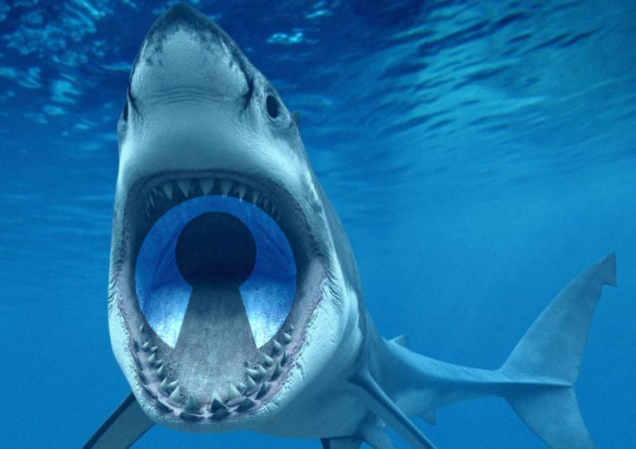
JAWS Wide Open
Glen Gordon & Steve Faulkner

Slide 2
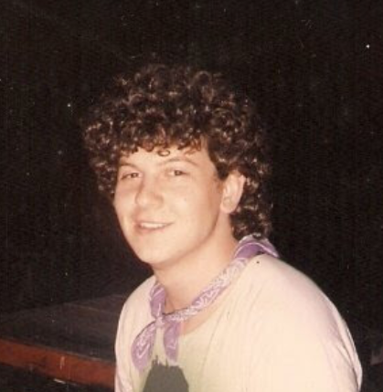
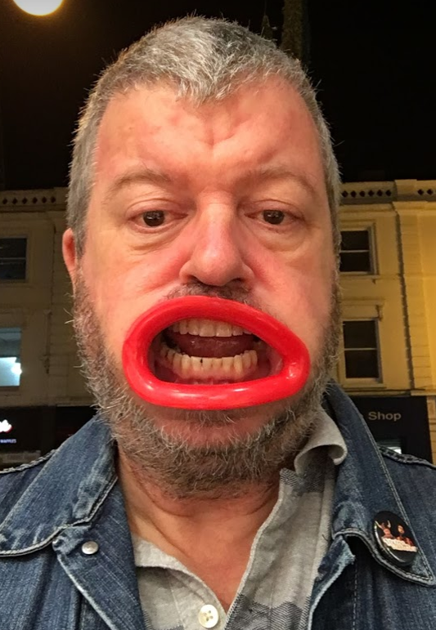
Not knowing has detrimental effects
Then
Now

Slide 3
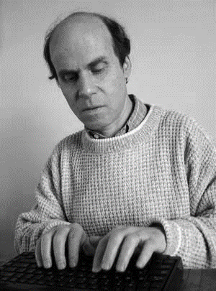
Having the knowledge brings benefits
Then
Now

Slide 4
The Genesis
CSUN 2017 – TPG met with Mat Ater, Glen Gordon and other VFO peeps to discuss how we could work together.
Pitched idea of an open bug tracker for JAWS concentrating on HTML/ARIA standards support
Got a (surprisingly) positive response from the Freedom crew

Slide 5
The Genesis
Initial fear that making bugs public would detract from JAWS reputation

Slide 6
The Genesis
Freedom didn’t have a good model for supporting developers

Slide 7
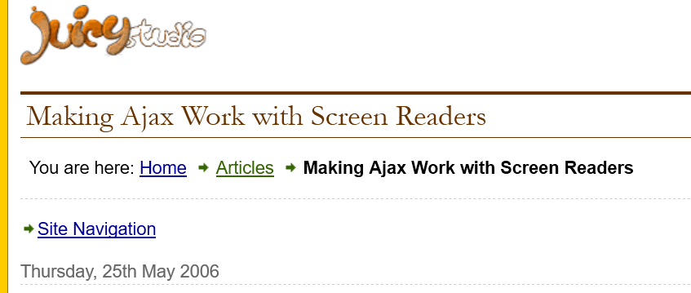
The Genesis
http://juicystudio.com/article/making-ajax-work-with-screen-readers.php

Slide 8
The central premises
Being able to file issues on an application and get feedback and see other peoples issues and feedback improves the software and the user experience

Slide 9
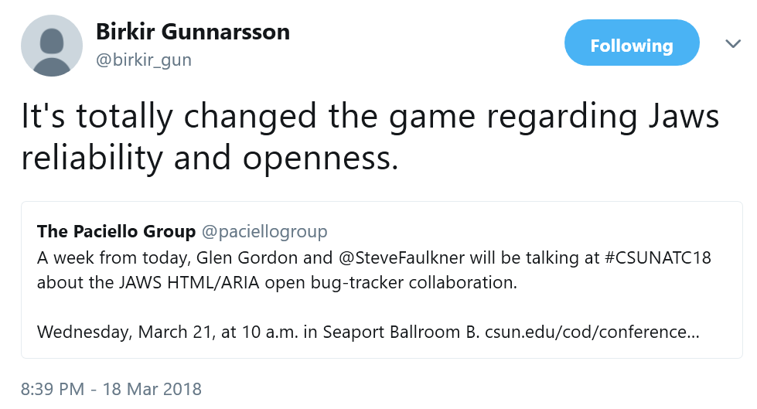
The central premises

Slide 10
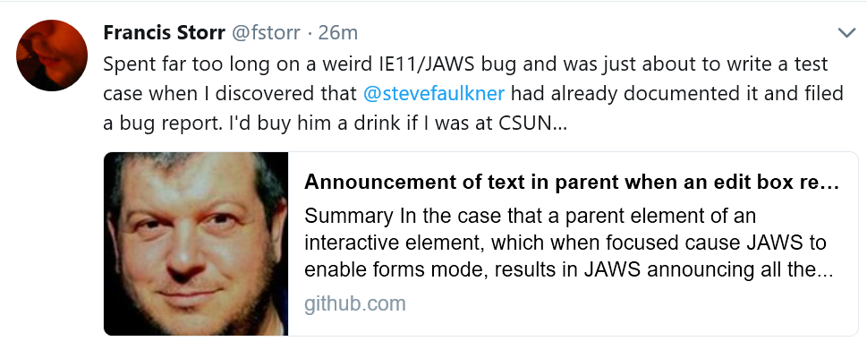
The central premises

Slide 11
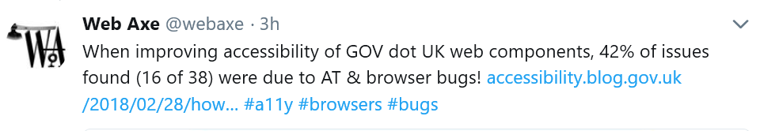
The central premises
Improving/explaining web standards support in screen readers (and browsers), makes it better for users, developers and the Web

Slide 12
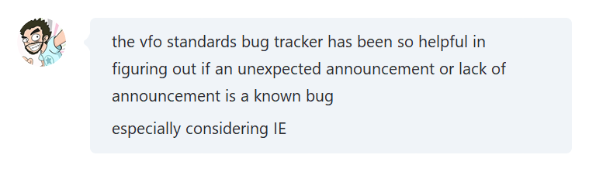
The central premises
Having a publicly available listing of known bugs, phantoms, fixes and workarounds is a great resource for developers and testers

Slide 13
The central premises
Increasing understanding of expected screen reader behaviour demystifies for everyone

Slide 14
Myth busting
Its not always screen readers that are the cause

Slide 15
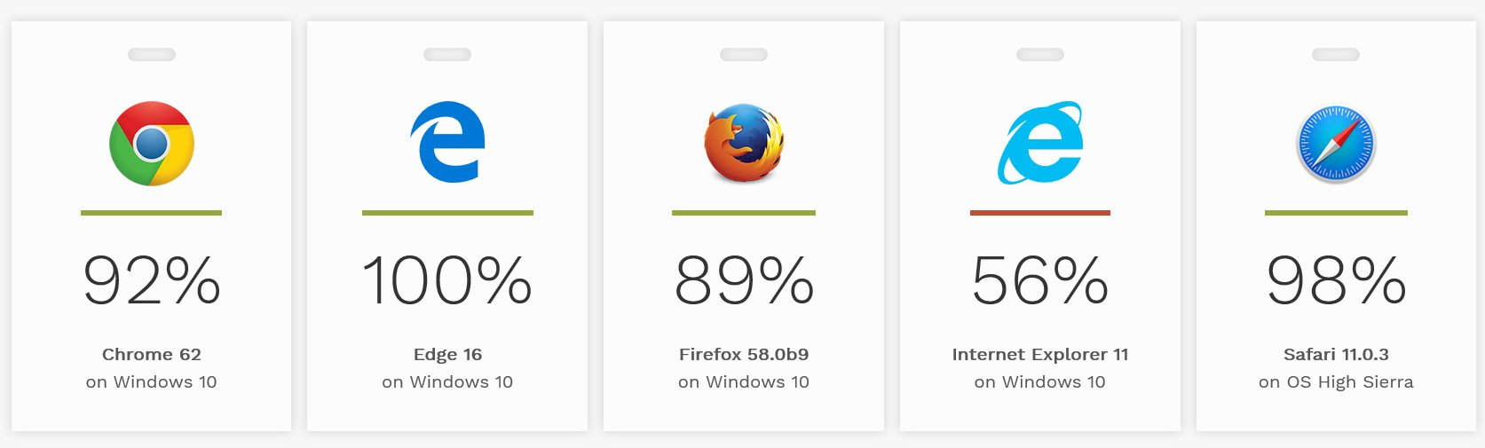
Myth busting
JAWS continues to have reputation for working best in IE

Slide 16
Myth busting
JAWS (actually) operates best with Firefox & Chrome which have superior user agent accessibility support

Slide 17
Myth busting
What about Edge?

Slide 18
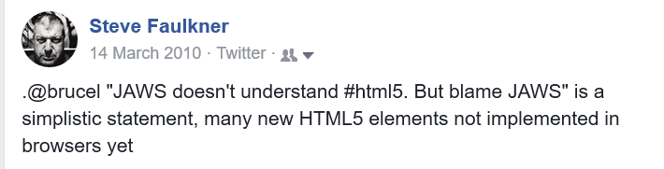
Myth busting
Screen readers don’t support web standards

Slide 19

Myth busting
Screen readers don’t support web standards
Yes they do

Slide 20
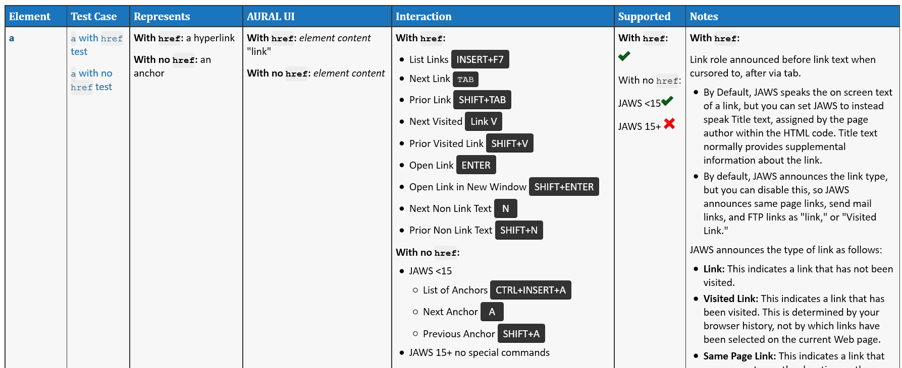
Myth busting
Screen readers don’t support web standards

Slide 21
Myth busting
Screen reader developers don’t fix bugs- latest JAWS fixes:
You can now select and copy text from web pages in Microsoft Edge. Currently, selecting by character, word, and line are supported.
When navigating by character in Edge, addressed an issue where JAWS was not indicating upper case characters.
When using the JAWS table reading commands to move through a table in Edge, resolved an issue where JAWS was not indicating links in table cells.
The O and SHIFT+O Navigation Quick Keys now move to the next and previous article on a web page. In addition, the CTRL+INSERT+O command now displays a list of articles on the page. The scripts for navigating by object are still available but are no longer assigned. They can be reassigned if needed using the Navigation Quick Key Manager accessed from the Run JAWS Manager dialog box (INSERT+F2).
Pressing APOSTROPHE or SHIFT+APOSTROPHE now moves to the next or previous tab control on a web page. You can also now press CTRL+INSERT+APOSTROPHE to display a list of all tab controls.
When encountering a separator on a web page, resolved an issue where JAWS was incorrectly reading several dashes before saying "separator".
Addressed an issue where JAWS was not automatically reading dialog boxes opened from web pages in Chrome or when using INSERT+B.
Resolved an issue where some tables were not being detected properly with JAWS 2018 even though they worked fine in JAWS 18.
Addressed a reported issue with the B and SHIFT+B Navigation Quick Keys not moving to menu buttons as expected.
Resolved an issue where JAWS custom labels assigned to edit fields were not being announced in Chrome.
If Forms mode is set to Auto or Semi-Auto, resolved a reported issue where Forms mode was not activating when navigating to a vertical slider using the TAB Key.

Slide 22
The execution
Github repository
Documents JAWS support for HTML and ARIA
Public issue tracker that anybody can raise an issue on
Issue raised
triaged
Bug filed
Bug tracked
Updates

Slide 23
The execution
TPG helps prioritize issues to be addressed
In the case of ambiguous standards, TPG ensures the right JAWS implementation

Slide 24
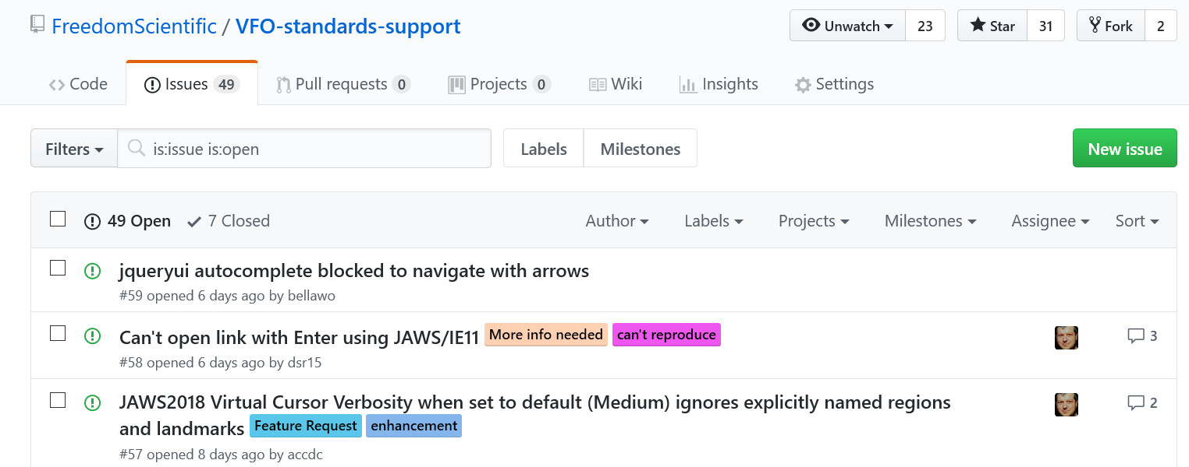
Next stop
File away!
https://github.com/FreedomScientific/VFO-standards-support/

Slide 25
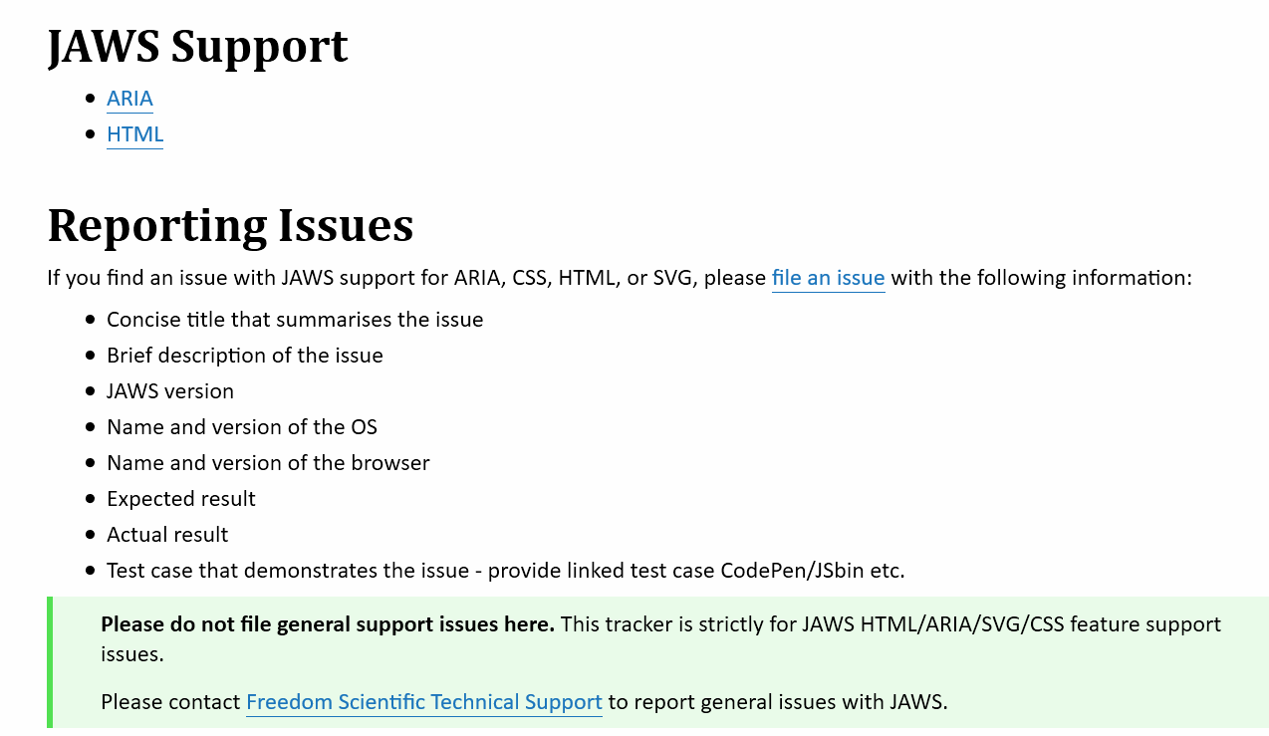
Next stop
JAWS HTML & ARIA Support Documentation
https://freedomscientific.github.io/VFO-standards-support/

